Slide 1

GeoAI Air Quality Susceptibility by ITU.
JULIUS M. MAINA
- Graduate Student-MSC (Data Analytics)
- Work: Financial Markets (Research)
- Interests: Time Series/ Earth Observation
- Currently Ranked 14/70000+ on Zindi

Slide 2
Agenda
Introduction
Data Analysis
Proposed
Solution
Results
Conclusion
&
Improvements
Presentation Title

Slide 3
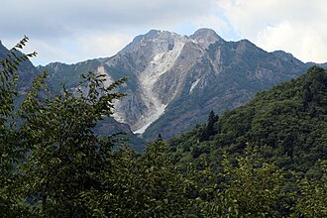
Introduction
Project Overview:
Milan, Italy, faces unique air quality challenges due to its geographical features.
Surrounded by the Alps and the Apennines, Milan experiences reduced wind circulation in the Po Valley, leading to air pollutant accumulation.
Air Quality Concerns:
Air pollution involves hazardous chemicals in the atmosphere, posing health risks.
Pollution is assessed using an air quality index, providing a comprehensive view of the overall pollution landscape.
Project Focus:
Utilize machine learning to create city-level air pollution susceptibility maps with a 5-meter spatial resolution.
Enable informed decision-making and enhance city resilience against environmental challenges.

Slide 4
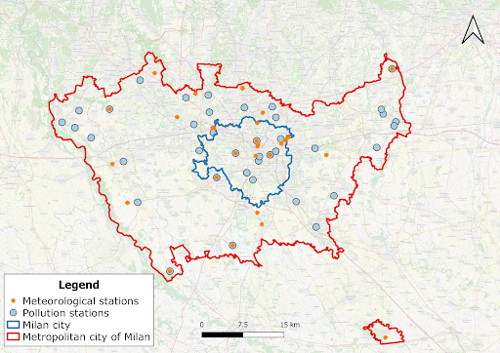
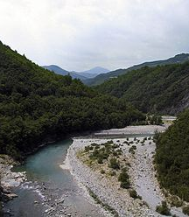
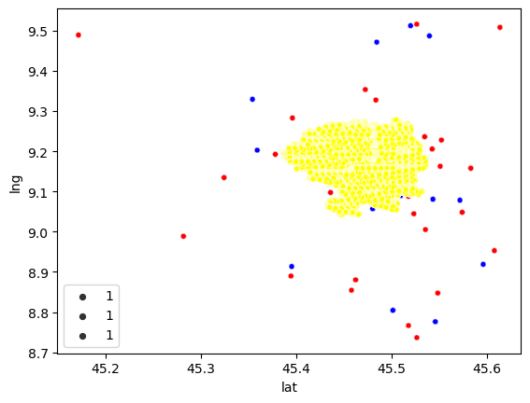
-Train data was from the metropolitan city (red boundary) and was from in-situ stations
-There are no enough in situ stations for air pollution monitoring for Milan City (blue boundary).
Data analysis
-Interpolated seasonal datasets for 2022 (shown in yellow) for the 4 seasons were concatenated to one dataset.
-Additional topographic data for Milan Commune (our target region), was provided

Slide 5

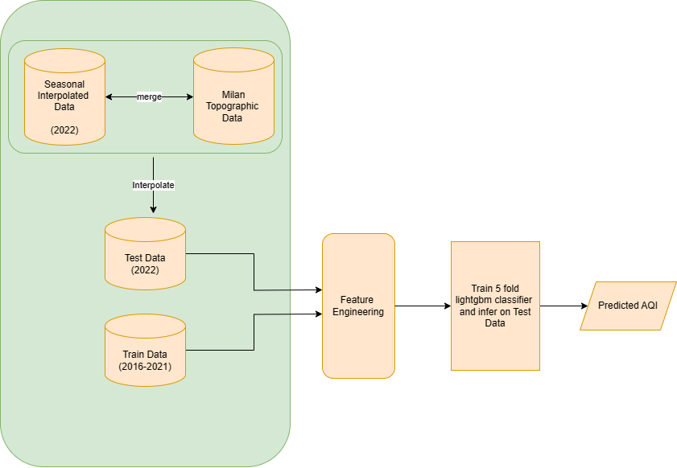
THE APPROACH
Data analysis
Feature Engineered:
- Location-based information
- Season in train
- Rotation features- rotating latitude and longitude by 45 & 30

Slide 6
Results -4 tree models on Selected Features
Accuracy, train time(seconds) and inference time(milliseconds) were used to track performance
Only default parameters were used for each of the models
Model | Accuracy CV | Accuracy Private LB | Train Time(s) | Inference Time (ms)
XGBoost | 0.7743 | 0.7857 | 593 | 3.0
LightGBM | 0.7384 | 0.8303 | 31 | 3.0
HistGradientBoosting | 0.7470 | 0.8035 | 64 | 16.1
CatBoost | 0.7685 | 0.8125 | 385 | 2.5
Ensemble (4) | x | 0.8035 | 1073 | 24.6

Slide 7
Results-Without Season
Without season feature, the results remained dismal
Model | Accuracy CV | Accuracy Private LB
XGBoost | 0.6996 | 0.3571
LightGBM | 0.6641 | 0.4642
HistGradientBoosting | 0.6723 | 0.4910
CatBoost | 0.375 | 0.4910
Ensemble (4) | x | 0.4642

Slide 8
Results-With Only Season Feature
Season feature alone gave a great score
Model | Accuracy CV | Accuracy Private LB
XGBoost | 0.5836 | 0.9910
LightGBM
HistGradientBoosting
CatBoost
Ensemble (4)

Slide 9
Results Across Various Types of Data
These results are only for LGBM our proposed model solution
Data | Accuracy CV | Accuracy Public LB | Accuracy Private LB
Lat, Lon, Season (No Interpolation) | 0.5836 | 1 | 0.9910
Meteorological Data | 0.6371 | 0.4791 | 0.4464
Geospatial/topographic | 0.4977 | 0.5 | 0.49
Land Cover Map | 0.5414 | 0.5 | 0.49
Geological Map | 0.4977 | 0.5 | 0.49
Engineered Features | 0.5836 | 1 | 0.9910
All Features | 0.7376 | 0.8541 | 0.8214
40 Selected Features | 0.7384 | 0.875 | 0.8303

Slide 10
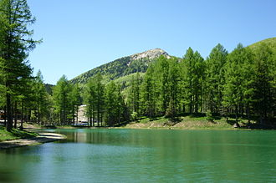
Conclusion
Season was a very important feature. LightGBM ranks the season feature as the fifth most important, while in other models, the season feature dominates as the most influential
LightGBM outperforms other models with the highest accuracy (83%) and the shortest training time (31 seconds). Ensembling results using mode still falls short of LightGBM's performance (80.35%)
Absence of real meteorological station data in the test set used, replaced by interpolated data, may contribute to the disparity in train vs leaderboard results.
Impact of feature selection on performance (83% with optimal feature choice vs. 82% with all features
Improvements
Try averaging AQI from other pollutants instead
Apply timeseries models
Use other open source datasets

Slide 11

Thank you
Julius Maina
Contact: julmngii@gmail.com

